Slide 1
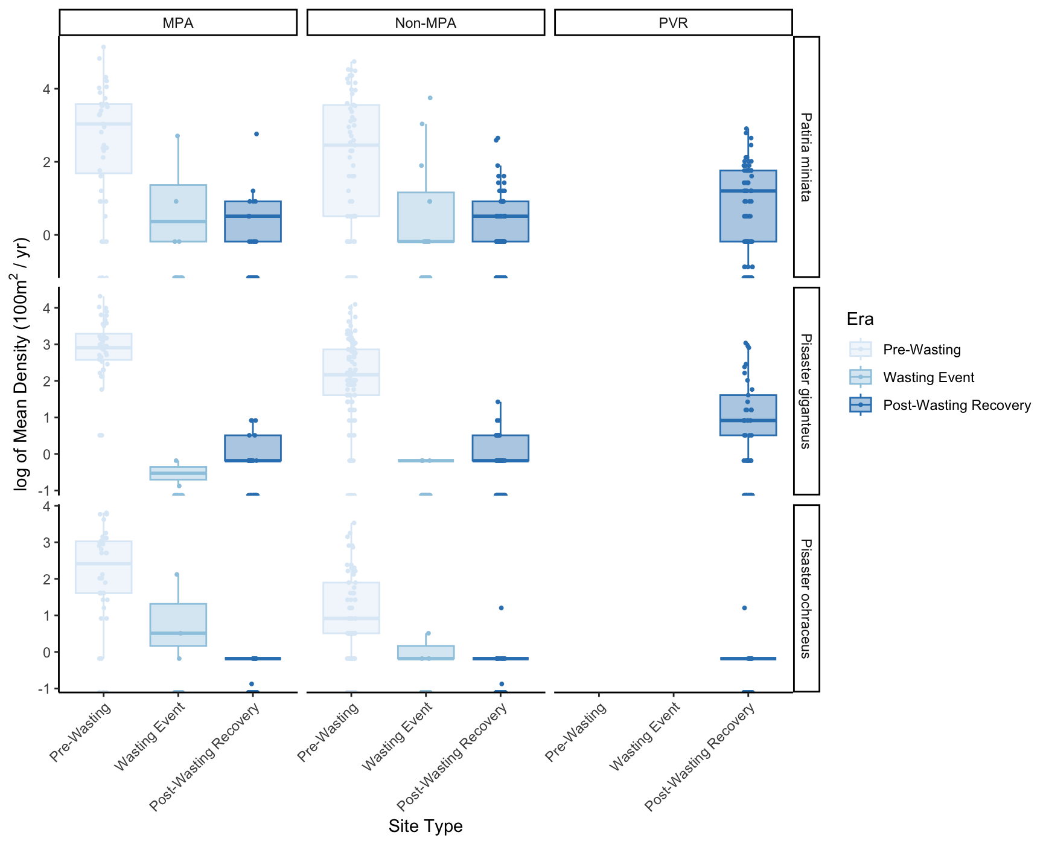
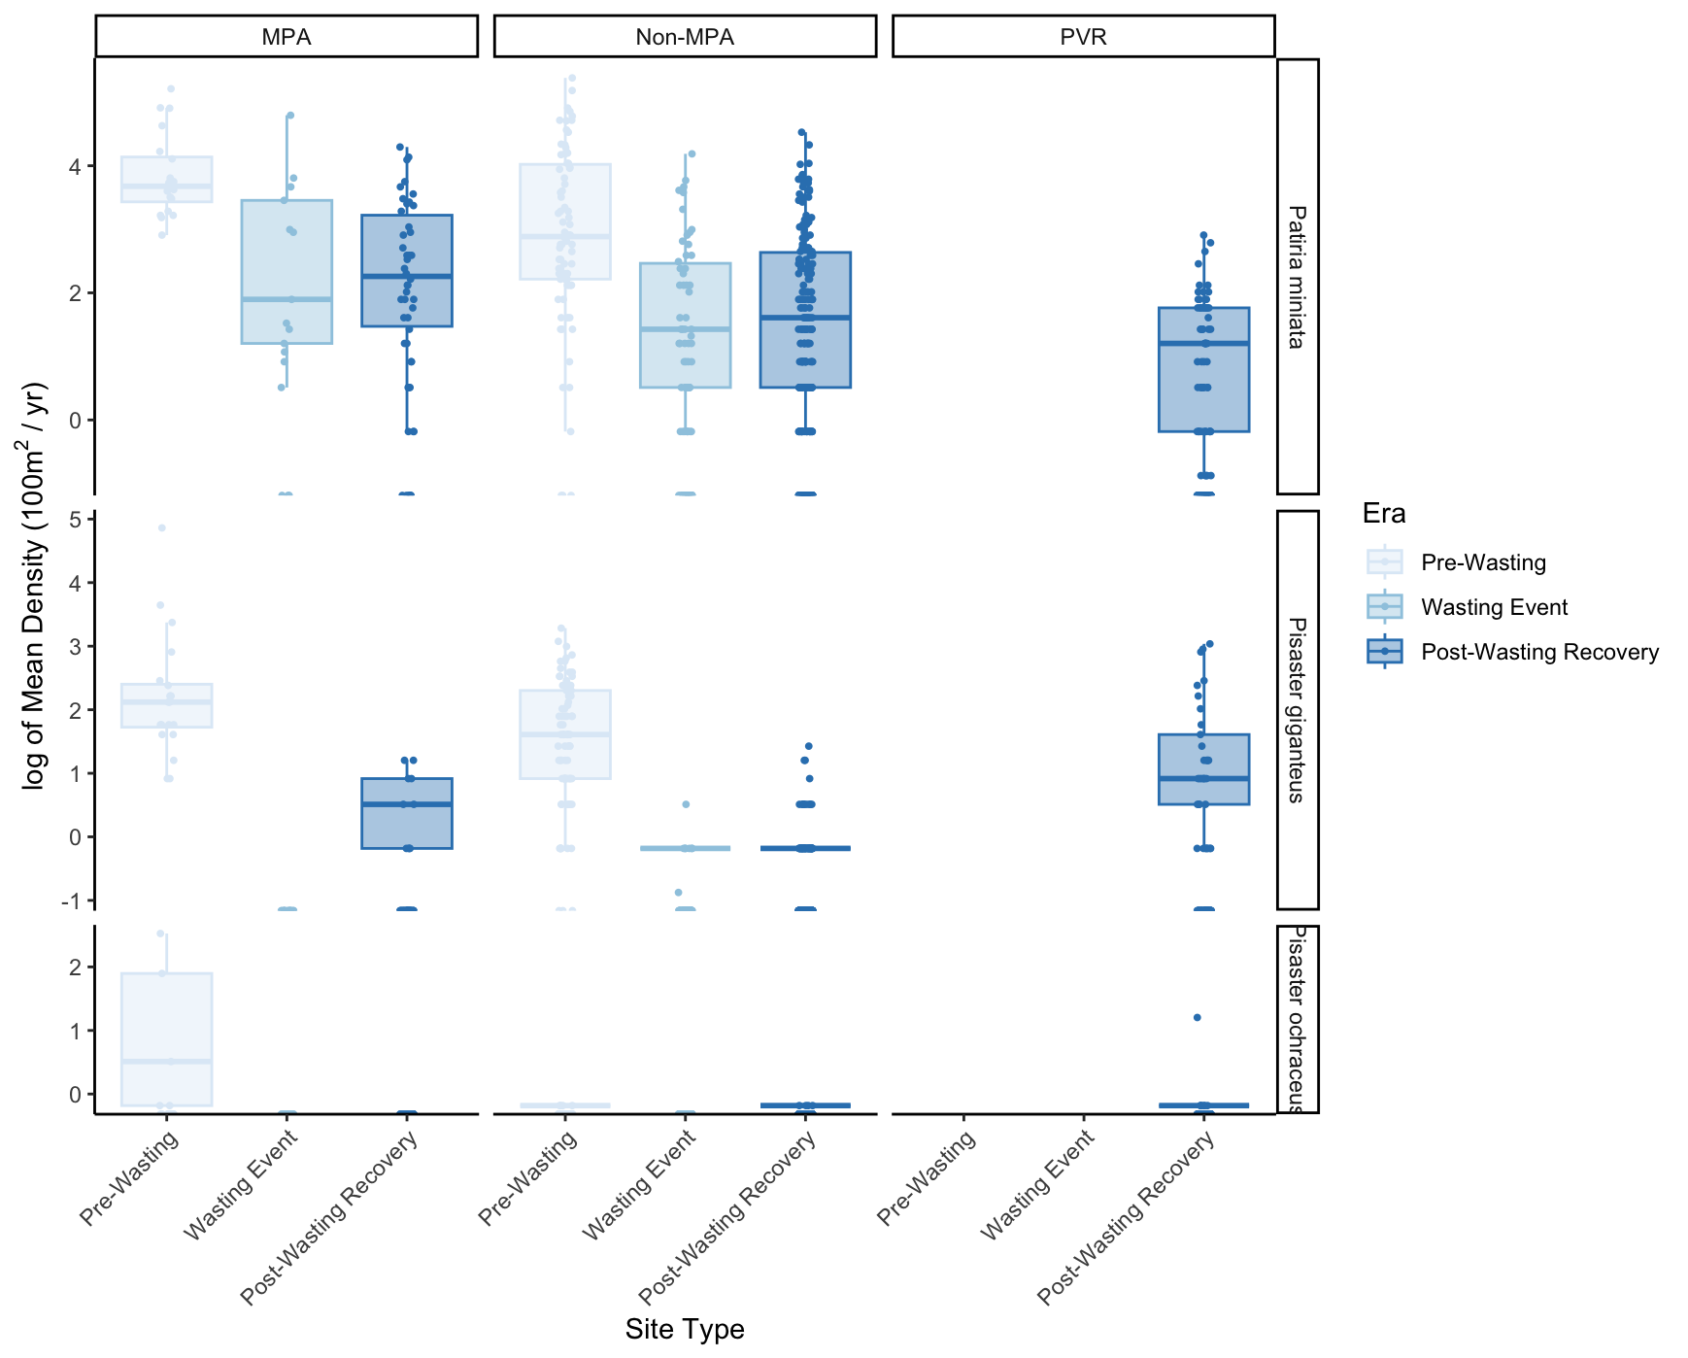
Sea Stars (2008 – 2024)
Inner, Middle vs ARM
Outer Middle, Outer, Deep vs ARM

Slide 2
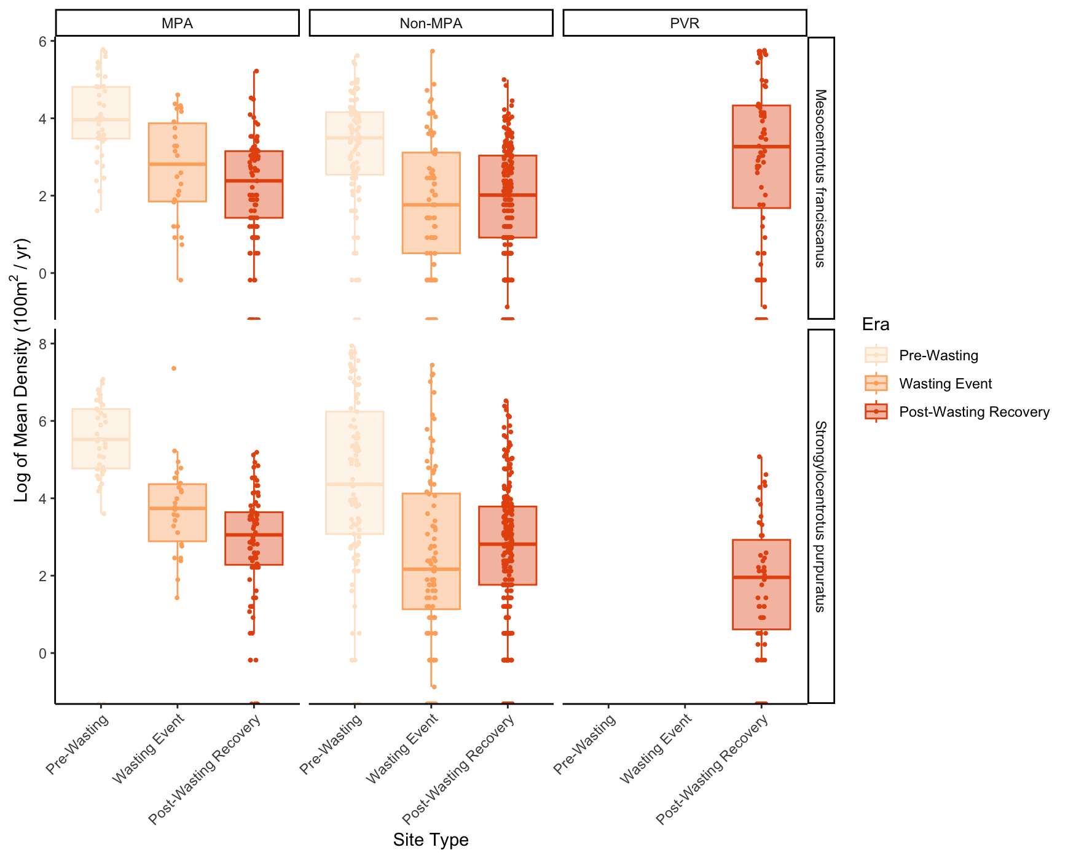
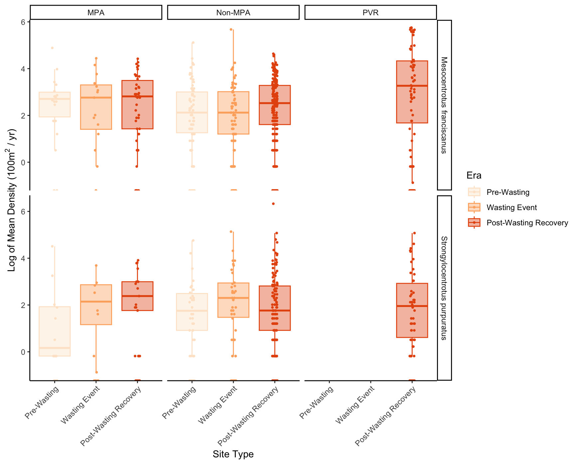
Urchins (2008 – 2024)
Inner, Middle vs ARM
Outer Middle, Outer, Deep vs ARM

Slide 3
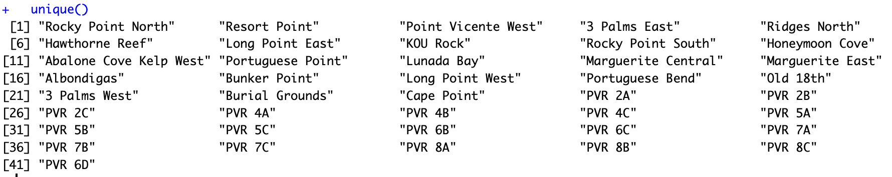
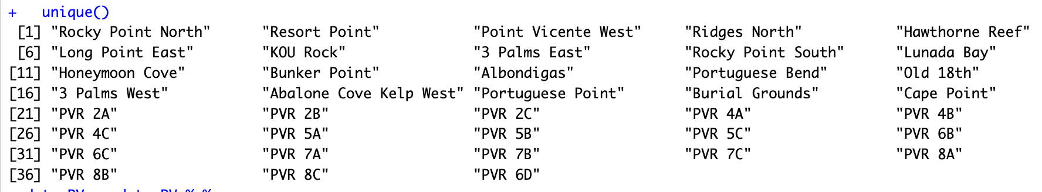
pink = unique to inner / middle
Site Lists
Inner, Middle vs ARM
Outer Middle, Outer, Deep vs ARM

